Slide 1
Hacxelerate - Windows 9/11
Ishayu Potey
Keyur Apte
Nayanesh Gudla
Atharva Sakpal

Slide 2
Domain - Cybersecurity
Problem Statement – Android device management

Slide 3
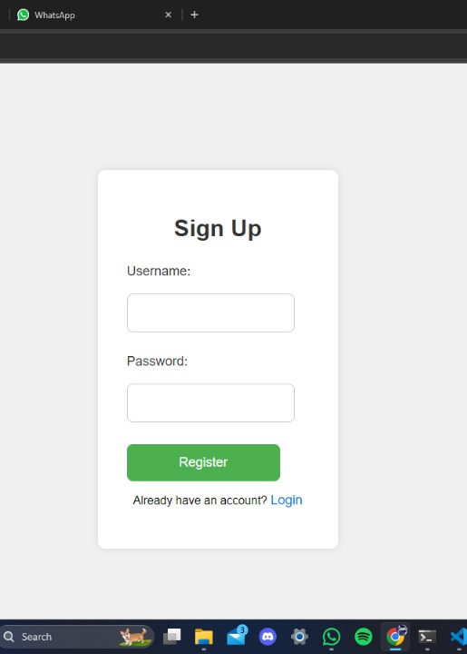
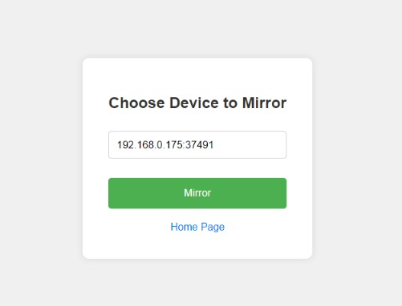
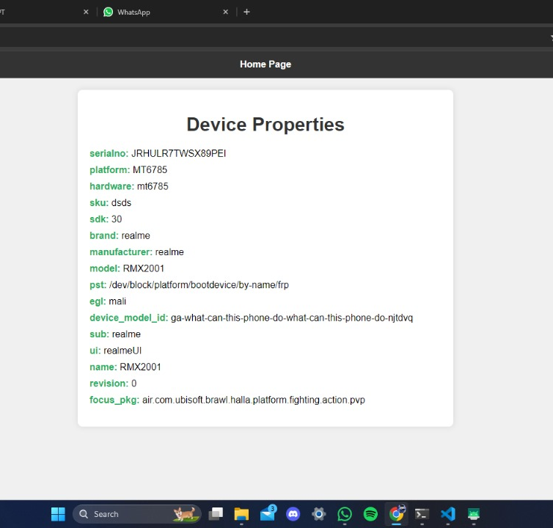
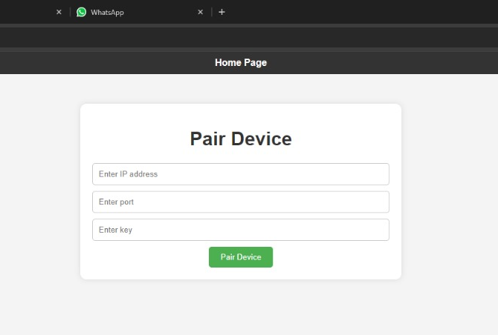
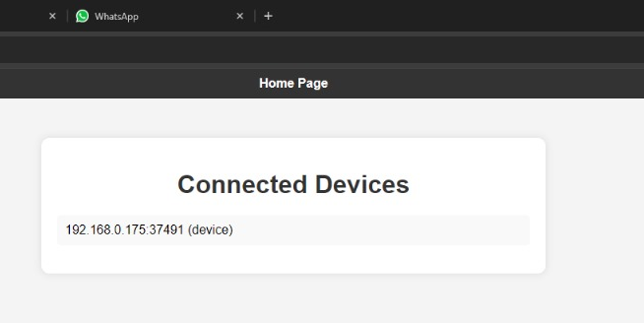

Slide 4
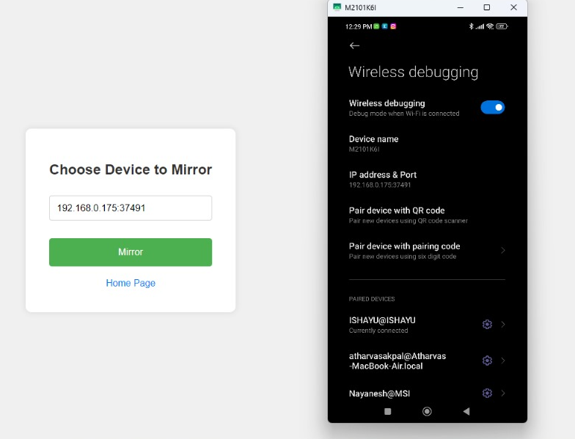
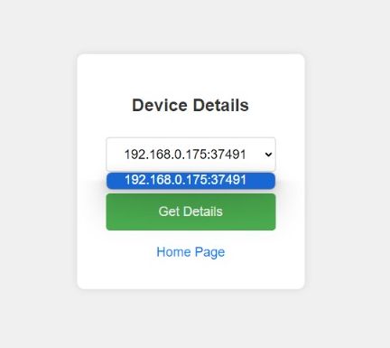
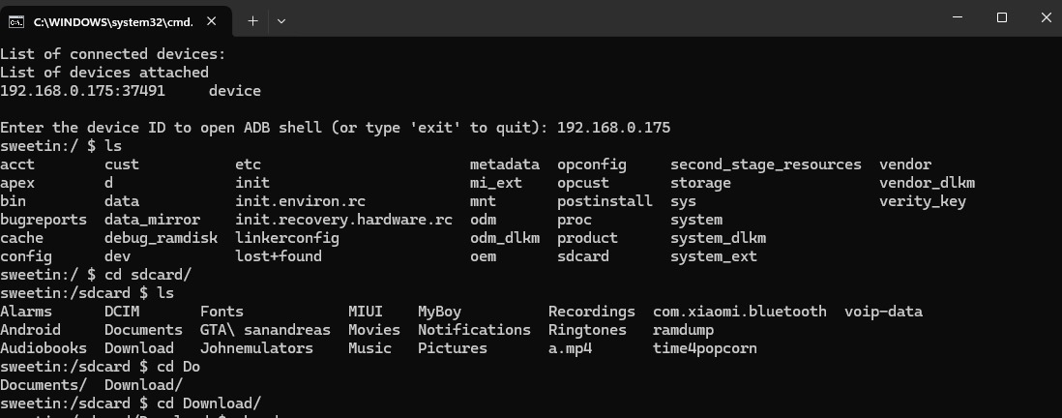

Slide 5
Approach -
To create a user dashboard that displays all connected devices/emulators and allows users to access them remotely, we have utilized Android Debug Bridge (ADB) Functionality to list connected Android devices or emulators, explore file systems, list installed apps, analyze basic network traffic (adb tcpip), and handle multiple devices. Adbkit has been integrated to simplify interaction with ADB.

Slide 6
We have leveraged the child_process module in Node.js to interact with ADB Functionality, automate tasks, and use the command prompt for device discovery, listing, and accessing ADB Shell for our web app. The child_process module has facilitated the integration of the Scrcpy Tool to initiate and terminate screen mirroring sessions, enabling our web app to have an interactive GUI. We have defined API endpoints in Express.js to start and stop screen mirror requests, and Scrcpy has handled concurrent access, ensuring multiple users cannot access the same device simultaneously.
To prevent multiple users from using the same device at once, we have implemented user authentication using Passport.js with the Mongoose ODM library to securely store user credentials. Additionally, we have employed the bcrypt.js library for password hashing to ensure secure storage.
For logging HTTP/S traffic, we have used a proxy server - Burp-Suite, and for basic traffic inspection, we have utilized the ADB Logcat command. Burp-Suite has provided us with self-signed CA certificates to work with.
We have built the user interface for the web application using HTML & CSS.

Slide 7
Utilities -
child_process (Node.js) for executing ADB and Scrcpy commands
Passport.js for User authentication
Burp Suite for HTTP/S Network Log Analysis
Bcrypt js Library for Password Library and Hashing

Slide 8
Tech Stack Used -
Frontend: HTML & CSS and javascript.
For a dynamic and responsive user interface.
Backend: Node.js with Express.js
for a robust web server and API endpoints.
Database: Mongoose ODM Library and Mongo-DB
for flexible storage of device data, user information, and potentially logs.
Authentication : Passport JS

Slide 9
Use Cases -
Centralized Control: Provides a single web interface to manage multiple Android devices and emulators, simplifying administration.
Remote Access: Enables users to interact with Android devices from anywhere, facilitating testing, support, or automation across distributed teams.
Automation: The ability to execute ADB commands via Node.js streamlines repetitive tasks on devices, saving time and effort.

Slide 10
Visual Interaction: Scrcpy integration provides a user-friendly, graphical way to control Android devices remotely, improving efficiency and ease of use.
Live Screen Mirroring : Scrcpy will enable real-time screen mirroring of Android devices and emulators, providing a seamless and interactive experience for user.
User Authentication : User authentication will be integrated into the web application to maintain personalized access for authorized users only.

